Slide 1

Intro to causality
Based on:
The Book Of Why By Judea Pearl
Brady Neal blog on causality
Causal Inference for the Brave and True blog by Matheus Facure
Shawhin Talebi blog
01.06.2023 Roy Segal

Slide 2

Agenda
MOTIVATION
THE PROBLEM
A SOLUTION
WHAT CAN WE DO WITH IT
EXAMPLE WITH NEUROSCIENCE
DISCUSSION

Slide 3
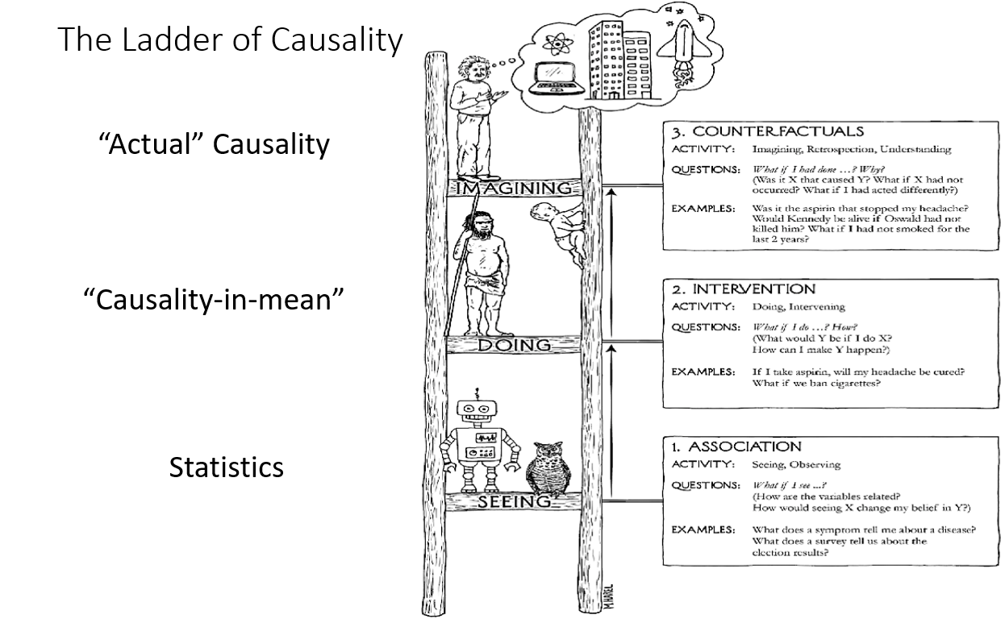

Slide 4
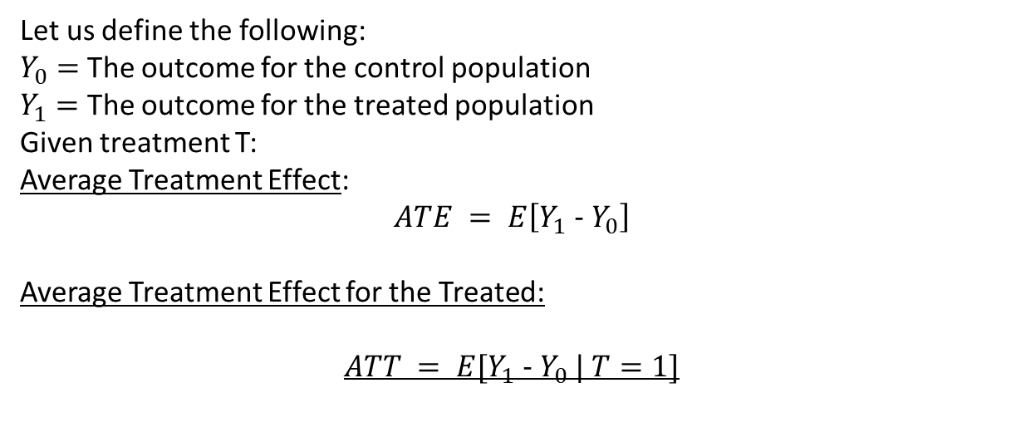
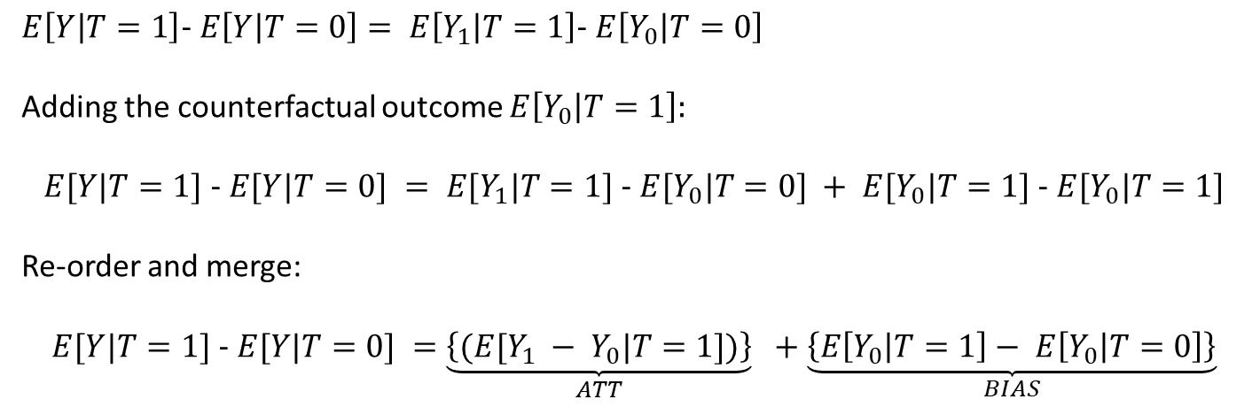
MOTIVATION
Let us define the following:
$Y_{0}=$ The outcome for the control population
$Y_{1}=$ The outcome for the treated population
Given treatment T:
Average Treatment Effect:
$$ATE = E\left[Y_{1} − Y_{0}\right]$$
Average Treatment Effect for the Treated:
$$ATT = E[Y_{1} − Y_{0} | T=1]$$
Causality instead of correlation
First Rung – What’s so bad about statistics?!?
Note that $Y_{0}$ is a counterfactual. In the real world we have:
$$E\left[Y | T=1\right]− E\left[Y | T=0\right]= E\left[Y_{1} | T=1\right]− E\left[Y_{0} | T=0\right]$$
Adding the counterfactual outcome $E\left[Y_{0} | T=1\right]:$
$$E[Y|T=1] − E[Y|T=0] = E[Y_{1}|T=1] − E[Y_{0}|T=0] + E[Y_{0}|T=1] − E[Y_{0}|T=1]$$
Re-order and merge:
$$E[Y|T=1] − E[Y|T=0] =\underset{ATT}{\underbrace{\left\{(E[Y_{1} − Y_{0}|T=1])\right\}}} +\underset{BIAS}{\underbrace{\left\{E\left[Y_{0} | T=1\right]− E\left[Y_{0} | T=0\right]\right\}}}$$
Notes:
Now, let’s add and subtract $E\left[Y_{0} | T=1\right]$ This is a counterfactual outcome. It tells what would have been the outcome of the treated, had they not received the treatment.
All this math just means that the average treatment affect for a treatment is the true affect for that treatment on the populations plus a bias term reflecting the difference of that sub-populations before the treatment. If they are the same, the ATT we measure will be the true affect.
Whats the solution? (hope they say RCT).
But RCT’s have problems – we can’t assign un-ethical treatments and most of our treatments (especially in neuroscience) are impossible to randomly assign (the brain is interconnected so randomly assigning treatment is problematic because the “control group” will never be purely controlled).
The ladder of causality and where we are
SIMPSON PARADOX, ALGORTIHMS THAT SEE A BAROMETER AND THINK ITS GONNA RAIN

Slide 5
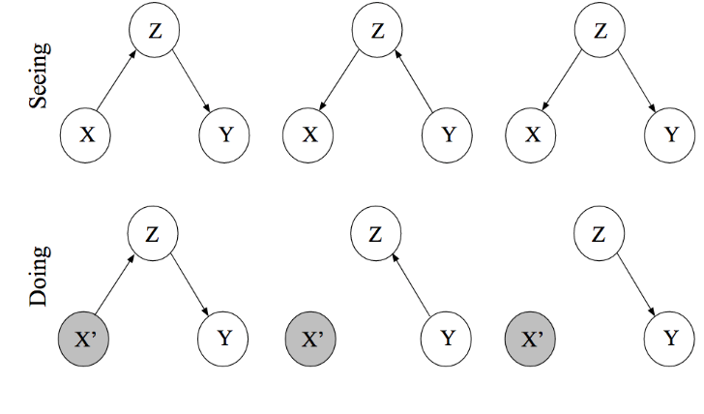
MOTIVATION
According to Pearl, RCT were the first dive into causality.
“the randomized controlled trial (RCT). From a causal perspective, the RCT is a man-made tool for uncovering the query P(L | do(D)), which is a property of nature. Its main purpose is to disassociate variables of interest (say, D and L) from other variables (Z) that would otherwise affect them both.”
Causality instead of correlation
What’s wrong with RCT?
Notes:
Graphical models are the language of causality. There are several frameworks to look at causality but we will focus on Pearl’s Structural Causal Models (SCM’s)
The intuition for the difference between P(Y|X) and P(Y|do(X)) is the difference between P(CANCER|SMOKING) and P(CANCER| I gave some random guy 20 cigarettes a day). They are different because I can imagine a situation where P(CANCER|SMOKING) has confounders like P(SMOKING| LESS SPORT) > 0.
In P(Y|do(X)) I manually set X=SMOKING and disentangle it from other causal relations as seen in the graph.
We cant always conduct a RCT (ethical or variables that cant be directly intervened on (like age))

Slide 6
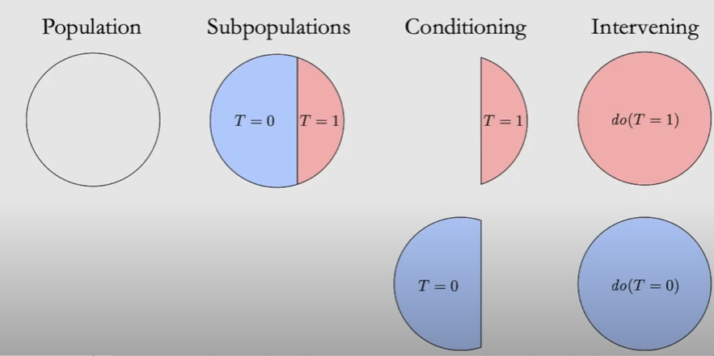
MOTIVATION
Difference between doing and intervention:
Causality instead of correlation
Confounding, then, should simply be defined as anything that leads to a discrepancy between the two
: P(Y | X) ≠ P(Y | do(X)).
Notes:
When intervening, we still look at the entire population, manually set to T=1.
When conditioning, we only look at part of the population.

Slide 7
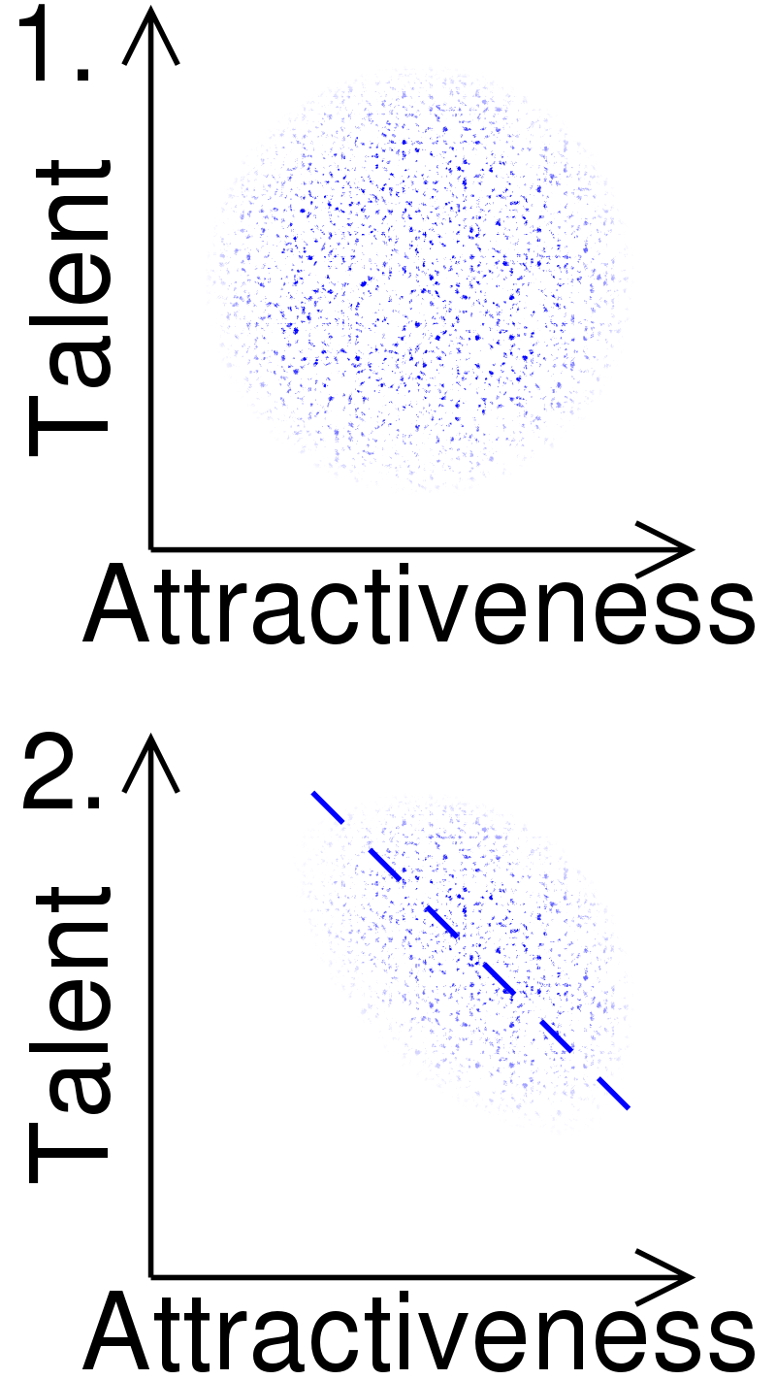
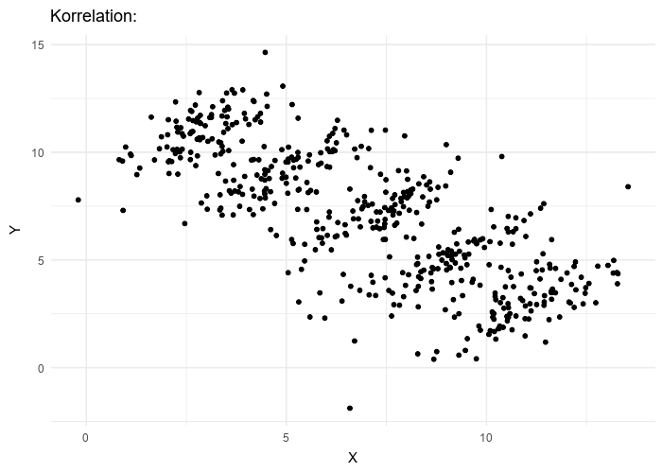
MOTIVATION
Berkson’s Paradox
Causality instead of correlation
Crash course GCM’s – forks and colliders:
Berkson’s Paradox and Simpson’s Paradox
Simpson’s paradox
Notes:
Berkson’s paradox – someone looking only at celebrities might think that theres a negative correlation between talent and attractiveness but this is because the average celebrity surpass a certain threshold of talent and attractiveness resulting in a negative correlation even though the average celebrity will be more talented and more attractive.
Simpson’s paradox – spurious correlations might result from conditioning on a collider.
There are claims that these are more frequent than people think because researchers tend to condition on everything possible to get a cleaner affect but the result is confounders like simpsons paradox. (like the article Benji Sent me)

Slide 8
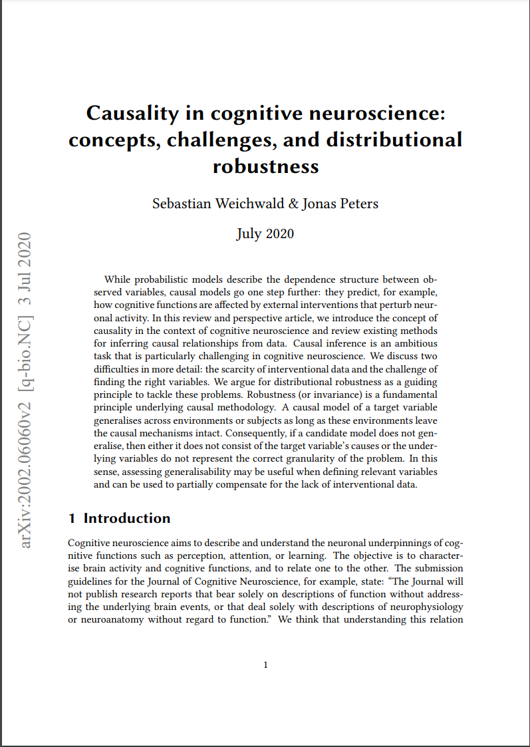
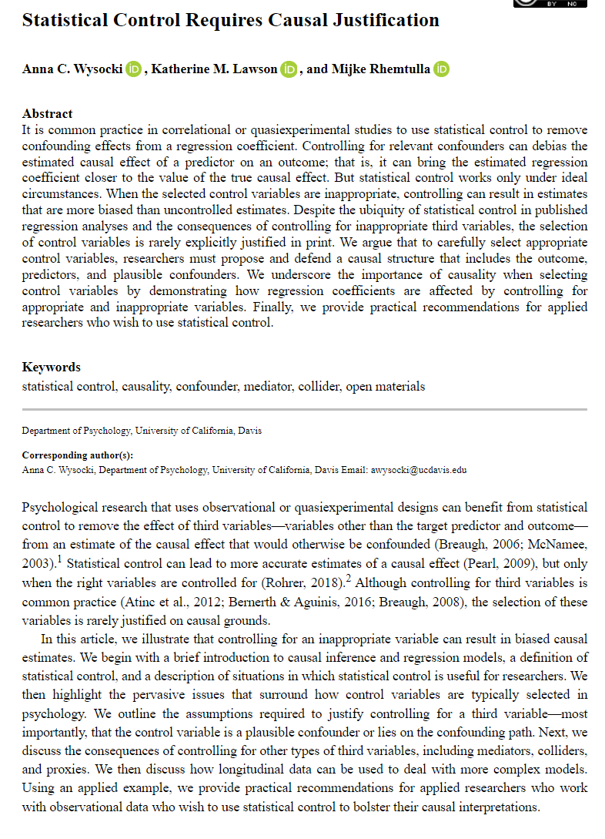
Notes:
Berkson’s paradox – someone looking only at celebrities might think that theres a negative correlation between talent and attractiveness but this is because the average celebrity surpass a certain threshold of talent and attractiveness resulting in a negative correlation even though the average celebrity will be more talented and more attractive.
Simpson’s paradox – spurious correlations might result from conditioning on a collider.
There are claims that these are more frequent than people think because researchers tend to condition on everything possible to get a cleaner affect but the result is confounders like simpsons paradox. (like the article Benji Sent me)

Slide 9
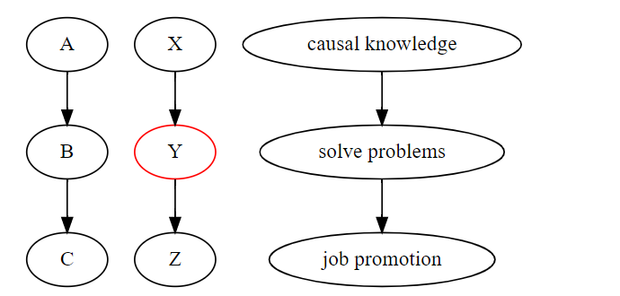
MOTIVATION
Causality instead of correlation
Crash course GCM’s
$$E\left[Promotion | Solve problems, Causal knowledge\right]= E\left[Promotion | Solve problems\right]$$
This graph suggests A is dependent on C or $A⊥C | B$
Notes:
Graphical models are the language of causality. There are several frameworks to look at causality but we will focus on Pearl’s Structural Causal Models (SCM’s)

Slide 10
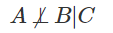
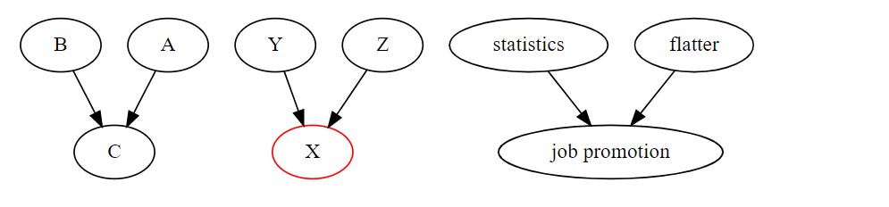
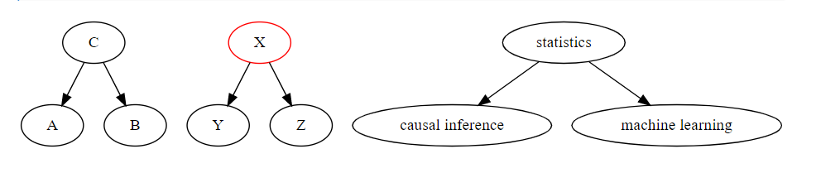
MOTIVATION
Collider (immorality)
This graph suggests $A⊥B or$
Causality instead of correlation
Crash course GCM’s – forks and colliders
Fork
This graph suggests A is dependent on B or $A⊥B | C$
Notes:
Graphical models are the language of causality. There are several frameworks to look at causality but we will focus on Pearl’s Structural Causal Models (SCM’s)
Collider – if I know some1 got job promotion, I know if he is bad at flattering it means he is good at statistics. A link is formed after conditioning on job promotion.
Forks – If I know you are good at machine learning, it probably means your good at statistics and causal inference.
Given I know you are good at statistics -> knowing your good at machine learning gives me no further knowledge about your expertise in causal inference.

Slide 11
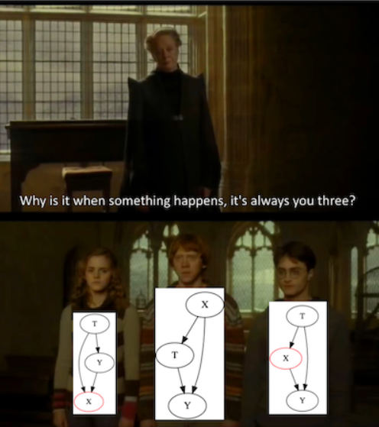
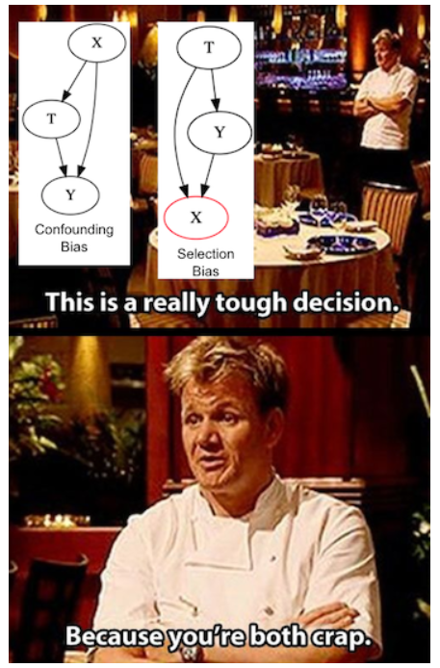

Slide 12
MOTIVATION
Recap
1) Observational data has problems
2) Interventional queries can be expressed using graphs and the do operator.
3) We can articulate rules for un-confounding if we know the causal graph of a system.
Causality instead of correlation
A bit more theory:
Back-door and front-door criteria –
Can we generalize rules for finding confounders?

Slide 13
The problem
Estimation portion of the flowchart
UNMEASURED CONFOUNDERS
We are here
Causal Estimand
Identification
Statistical Estimand
Estimation
Estimate
P(Y|do(X))
Causal model
(DAG)
Notes:
We now have learned what is called a causal estimand. This is the recipe by which we follow to get the estimation for the causal affect.

Slide 14
MOTIVATION
Causality instead of correlation
Insights leading to the backdoor and frontdoor adjustments
In a chain junction, A B C, controlling for B prevents information about A from getting to C or vice versa.
Likewise, in a fork or confounding junction, A B C, controlling for B prevents information about A from getting to C or vice versa.
Finally, in a collider, A B C, exactly the opposite rules hold. The variables A and C start out independent, so that information about A tells you nothing about C. But if you control for B, then information starts flowing through the “pipe,” due to the explain-away effect.
Controlling for descendants (or proxies) of a variable is like “partially” controlling for the variable itself. Controlling for a descendant of a mediator partly closes the pipe; controlling for a descendant of a collider partly opens the pipe.

Slide 15
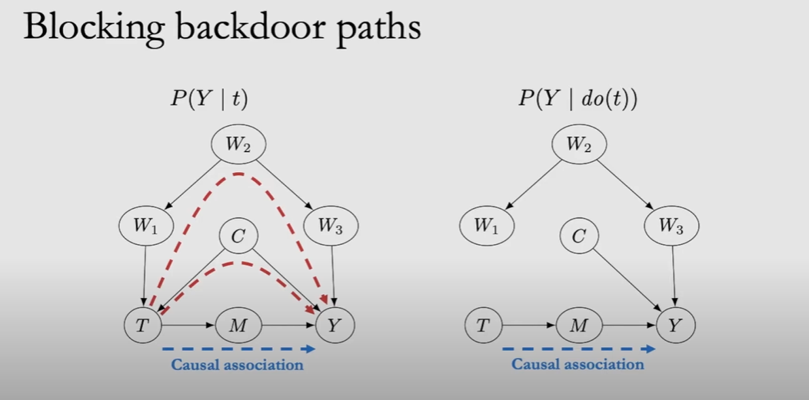
MOTIVATION
Causality instead of correlation

Slide 16
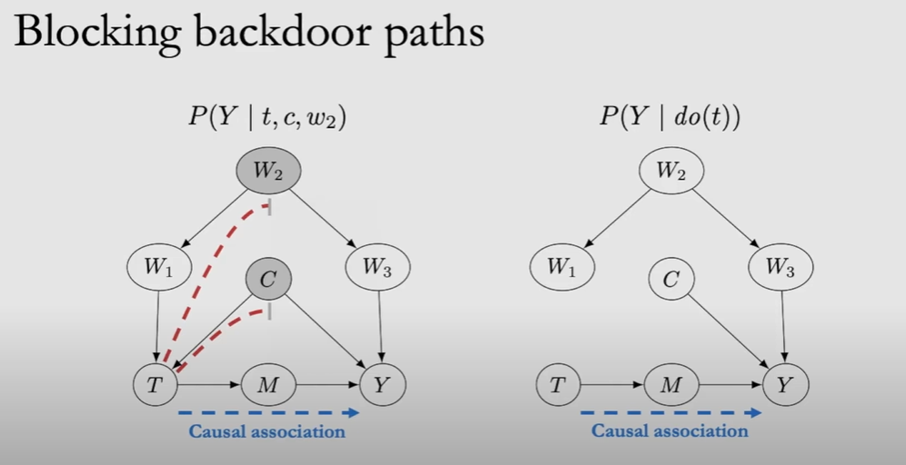
MOTIVATION
Causality instead of correlation
Notes:
We can mimick the do operator if we block backdoor paths!

Slide 17
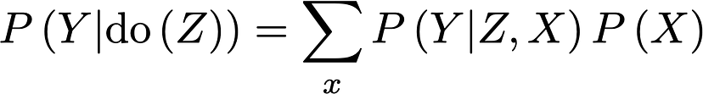
MOTIVATION
Backdoor criteria – when can we adjust
Causality instead of correlation
A set of W satisfies the backdoor criterion relative to T and Y if the following are met:
W blocks all backdoor paths from T to Y.
W does not contain any descendants of T.
Given the modularity assumption and that W satisfies the backdoor criterion, we can identify the causal effect of T on Y:
Notes:
Modularity assumption :
If we intervene on node X, then the only mechanism P(X_i}pa_i) changes. All other mechanisms P(x_j|pa_j) where i=!j remains unchanged.
In other words, all the causal mechanisms are modular. Changes are local.

Slide 18
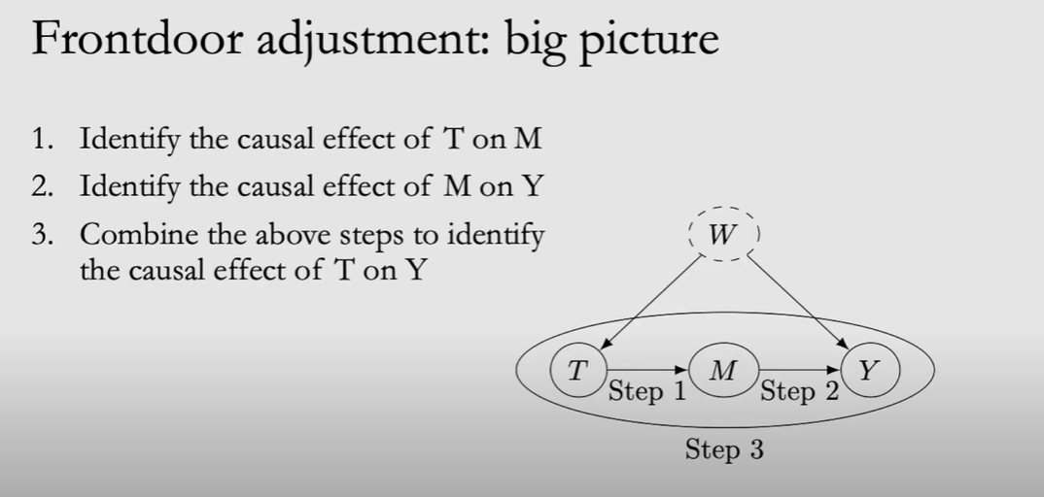
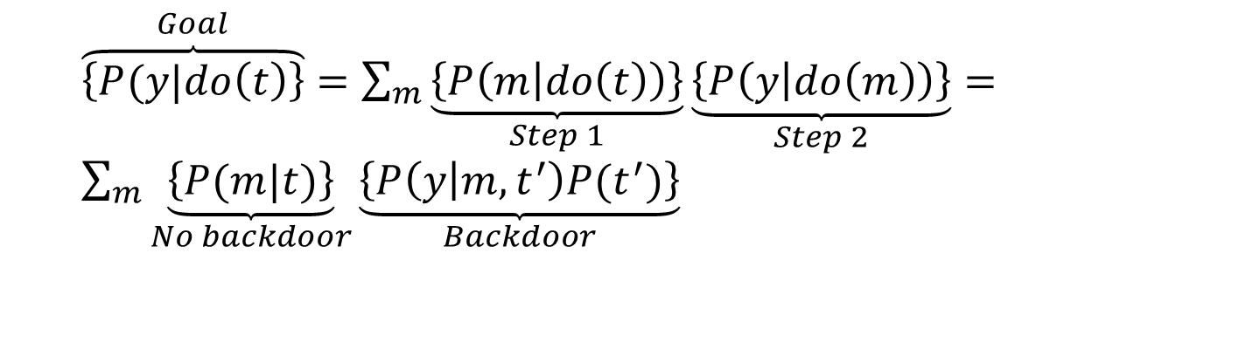
MOTIVATION
Front door adjustment
Causality instead of correlation
$\overset{Goal}{\overbrace{\left\{P(y|do\left(t\right)\right\}}}=\sum_{m}{\underset{Step 1}{\underbrace{\left\{P\left(m | do\left(t\right)\right)\right\}}}\underset{Step 2}{\underbrace{\left\{P\left(y | do\left(m\right)\right)\right\}}}}=$ $\sum_{m}{\underset{No backdoor}{\underbrace{\left\{P(m|t)\right\}}}\underset{Backdoor}{\underbrace{\left\{P\left(y | m,t^{′}\right)P(t^{′})\right\}}}}$
Notes:
(W is unobserved so we can’t condition on it)

Slide 19
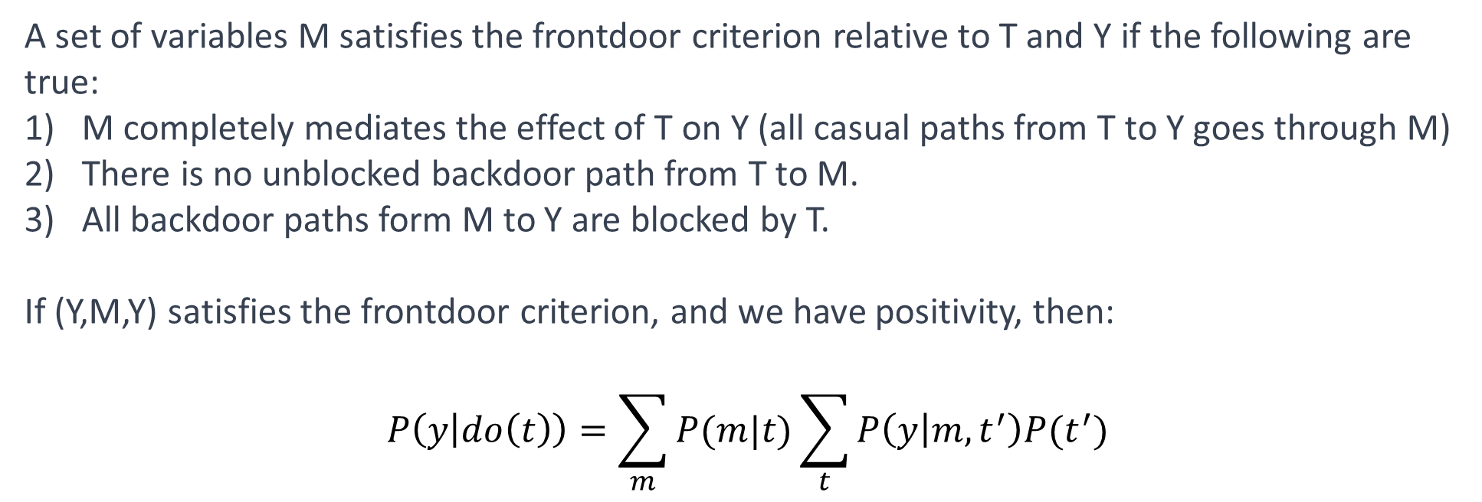
MOTIVATION
Front door adjustment – when can we adjust
Causality instead of correlation
A set of variables M satisfies the frontdoor criterion relative to T and Y if the following are true:
M completely mediates the effect of T on Y (all casual paths from T to Y goes through M)
There is no unblocked backdoor path from T to M.
All backdoor paths form M to Y are blocked by T.
If (Y,M,Y) satisfies the frontdoor criterion, and we have positivity, then:
$$P\left(y | do\left(t\right)\right)=\sum_{m}{P(m|t)\sum_{t}{P\left(y | m,t^{′}\right)P(t^{′})}}$$
Notes:
This can help us turn a study with observational data to an RCT.
We can test our hypothesis using the criterias and a DAG built on our assumptions.
https://12ft.io/proxy?q=https%3A%2F%2Fmedium.data4sci.com%2Fcausal-inference-part-xii-front-door-criterion-38bec5172f3e for example
https://github.com/DataForScience/Causality/blob/master/3.4%20-%20Front-Door%20Criterion.ipynb

Slide 20
MOTIVATION
Causality instead of correlation
But if we have a DAG that doesn’t satisfy the backdoor and front door criteria?
Notes:
Assumption 1: The first assumption is that the smoking gene has no effect on the formation of tar deposits, which are exclusively due to the physical action of cigarette smoke.
The second significant assumption is that Smoking leads to Cancer only through the accumulation of tar deposits.

Slide 21
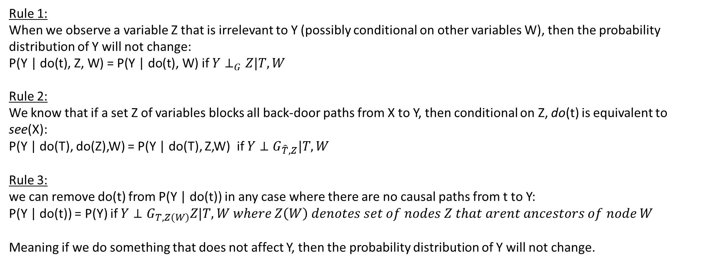
MOTIVATION
Pearl’s do-calculus
Causality instead of correlation
Allow us to identify any causal quantity that is identifiable
Rule 1:
When we observe a variable Z that is irrelevant to Y (possibly conditional on other variables W), then the probability distribution of Y will not change:
$\text{P}\text{(}\text{Y}\text{ | }\text{do}\text{(}\text{t}\text{), }\text{Z}\text{, }\text{W}\text{) = }\text{P}\text{(}\text{Y}\text{ | }\text{do}\text{(}\text{t}\text{), }\text{W}\text{)}$ if $Y⊥_{G}Z|T,W$
Rule 2:
We know that if a set Z of variables blocks all back-door paths from X to Y, then conditional on Z, do(t) is equivalent to see(X):
P(Y | do(T), do(Z),W) = P(Y | do(T), Z,W) if $Y⊥G_{\hat{T},Z}|T,W$
Rule 3:
we can remove do(t) from P(Y | do(t)) in any case where there are no causal paths from t to Y:
P(Y | do(t)) = P(Y) if $Y⊥G_{T,Z\left(W\right)}Z|T,W where Z\left(W\right) denotes set of nodes Z that arent ancestors of node W$
Meaning if we do something that does not affect Y, then the probability distribution of Y will not change.
Peal’s do calculus is complete: if causal estimates are identifiable, they will be identified by do calculus.
(Shpitser & Pearl, 2006a; Huang & Valtora, 2006; Shpitser & Pearl, 2006b)
Notes:
Note that each rule has a simple syntactic interpretation. Rule 1 permits the addition or deletion of observations. Rule 2 permits the replacement of an intervention with an observation, or vice versa. Rule 3 permits the deletion or addition of interventions. All of these permits are issued under appropriate conditions, which have to be verified in any particular case from the causal diagram.
Rule 1 : generalization of d-separation, Rule 2: generalization of backdoor adjustment. Rule 3:
Do calculus is complete given unconfounded children criterion and another criterion.

Slide 22
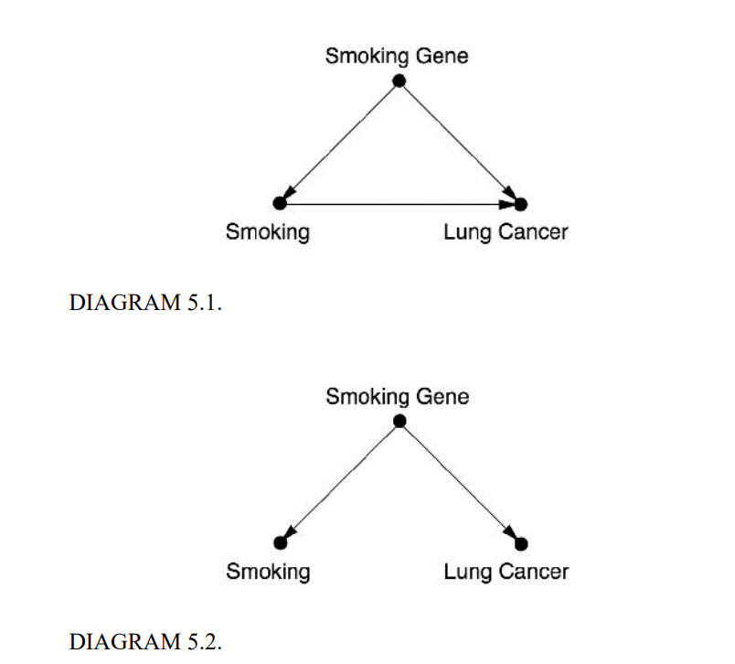
MOTIVATION
Cigarettes and cancer – real life example
During the smoking-cancer debate in the 50’s, R.A. Fisher was a fierce advocate of smoking and would discredit any study that tried to show a link to cancer saying it is biased and that any observational association is spurious.
Cornfield’s inequality
If a spurious correlation is the result of cancer in smokers, we can accumulate the source to an imaginary smoking gene.
It is mathematically impossible for an existence of smoking gene explaining all the correlation between smoking and lung cancer.
Causality instead of correlation
Notes:
Fisher claimed a gene might be causing ppl to smoke and also to get cancer, explaining the correlation between smoking and lung cancer.
He claimed that nothing short of a RCT would settle the issue.
That is because if the gene exists equally in the population, if 11 percent of non-smokers have it, then 99 percent of smokers would have it.
Also a gene cant explain why ppl who quit smoking have a lower chance of lung cancer.
Proof on the web

Slide 23
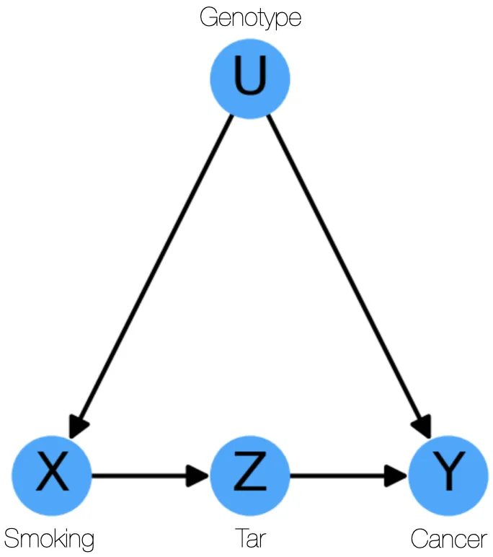
MOTIVATION
What if Pearl was Cornfield (example from the book)
Causality instead of correlation
Notes:
Assumption 1: The first assumption is that the smoking gene has no effect on the formation of tar deposits, which are exclusively due to the physical action of cigarette smoke.
The second significant assumption is that Smoking leads to Cancer only through the accumulation of tar deposits.

Slide 24
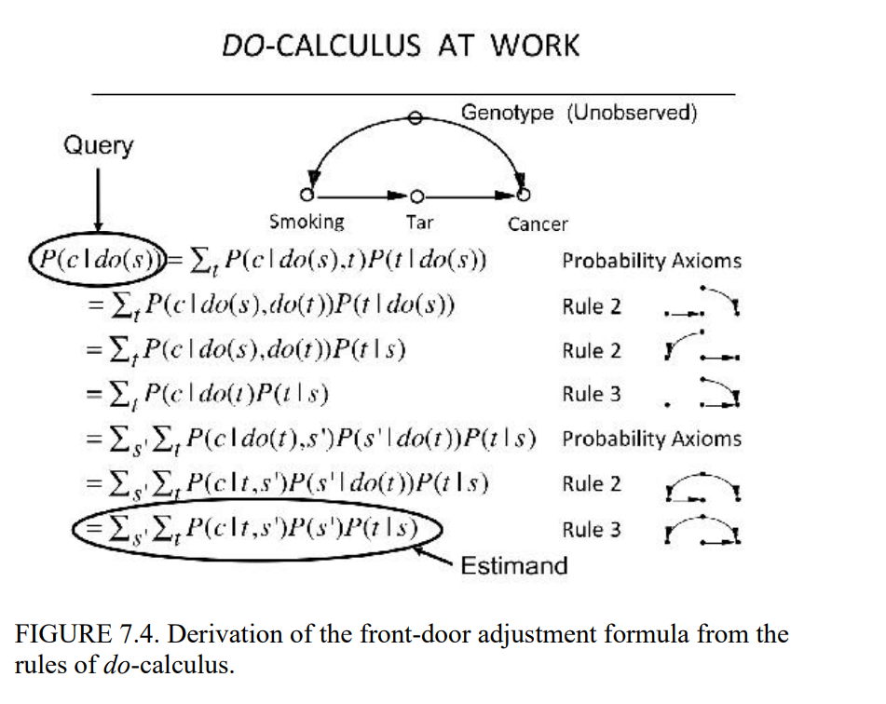
MOTIVATION
How will it look?
Causality instead of correlation
Notes:
Assumption 1: The first assumption is that the smoking gene has no effect on the formation of tar deposits, which are exclusively due to the physical action of cigarette smoke.
The second significant assumption is that Smoking leads to Cancer only through the accumulation of tar deposits.

Slide 25
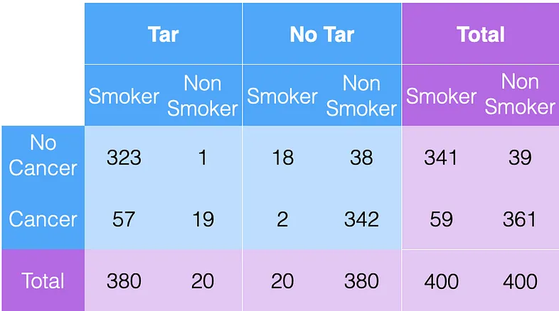
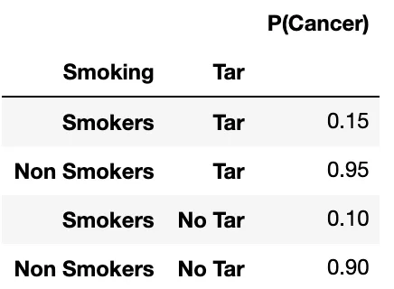
MOTIVATION
How will it look?
Causality instead of correlation
Notes:
Assumption 1: The first assumption is that the smoking gene has no effect on the formation of tar deposits, which are exclusively due to the physical action of cigarette smoke.
The second significant assumption is that Smoking leads to Cancer only through the accumulation of tar deposits.

Slide 26
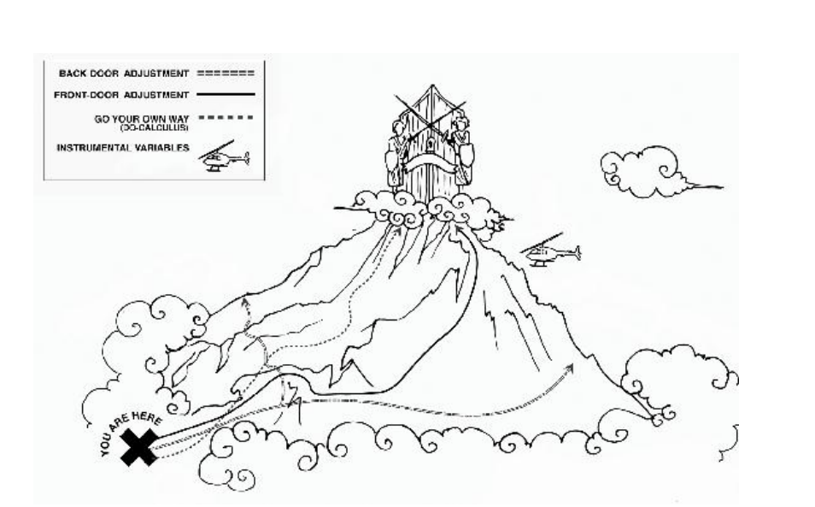
MOTIVATION
The conquest of mount intervention.
Causality instead of correlation
Notes:
How to get from observational to interventional.

Slide 27
The problem
Estimation portion of the flowchart
UNMEASURED CONFOUNDERS
We are here
Causal Estimand
Identification
Statistical Estimand
Estimation
Estimate

Slide 28
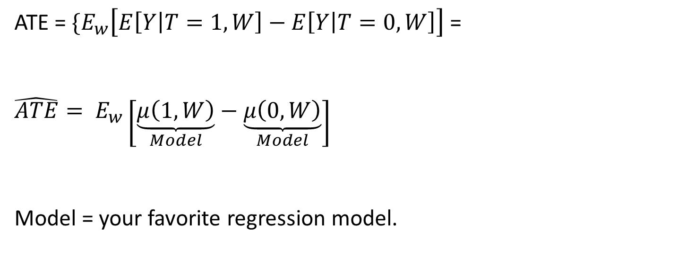
MOTIVATION
Causality instead of correlation
Conditional outcome modeling (COM):
ATE = ${\{E}_{w}\left[E\left[Y | T=1, W\right]−E\left[Y | T=0,W\right]\right]$ =
$${\hat{ATE}= E}_{w}\left[\underset{Model}{\underbrace{μ\left(1,W\right)}}−\underset{Model}{\underbrace{μ\left(0,W\right)}}\right]$$
Model = your favorite regression model.
Notes:
How to get from observational to interventional.

Slide 29
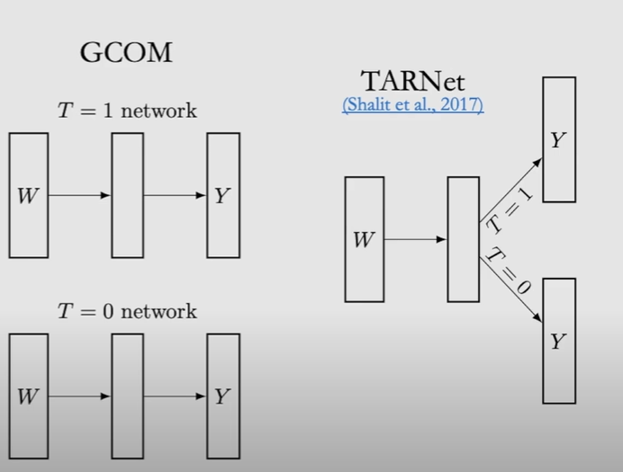
MOTIVATION
Causality instead of correlation
Other ways to estimate:
GCOM
Meta learners( S- learner, T-learner, X-learner)
TARNET
Double Machine Learning
Anchor regression
Notes:
How to get from observational to interventional.

Slide 30
MOTIVATION
Causality instead of correlation
How to estimate in environments of unobserved confounders
Setting bounds
Notes:
How to get from observational to interventional.

Slide 31
MOTIVATION
Causality instead of correlation
What’s BCI
UNMEASURED CONFOUNDERS

Slide 32
MOTIVATION
Causality instead of correlation
But what if we don’t know the graph?

Slide 33
MOTIVATION
Causality instead of correlation
Independence based VS Semi-Parametric Causal Discovery
Notes:
In semi parametric we need to make assumption on the parametric form of the graph.

Slide 34
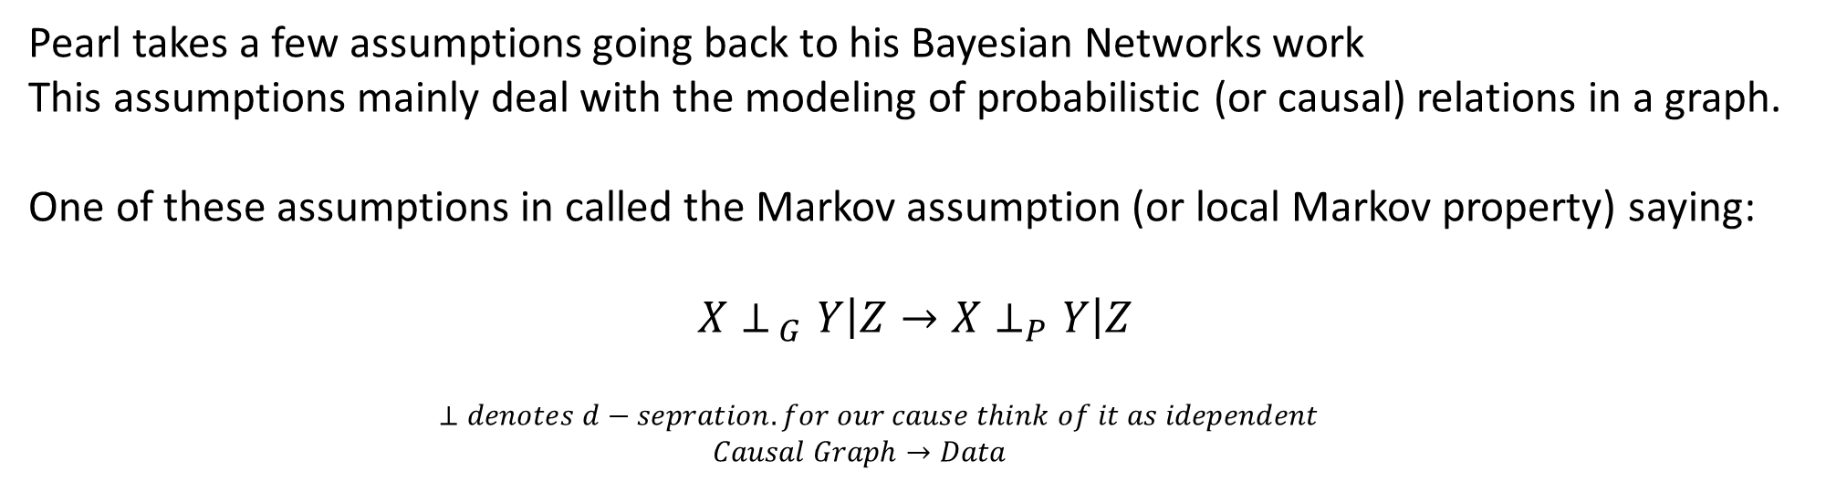
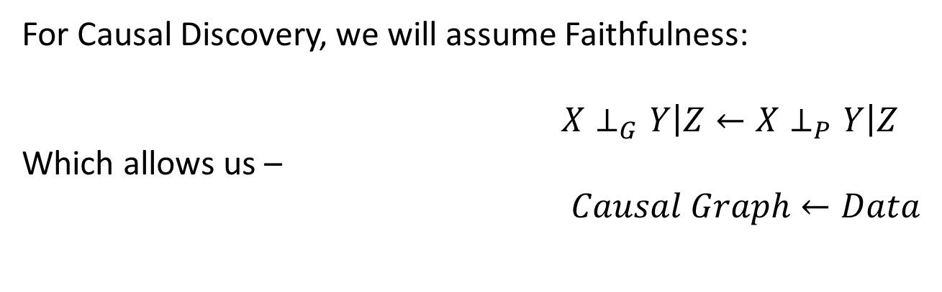
MOTIVATION
Causality instead of correlation
Pearl takes a few assumptions going back to his Bayesian Networks work
This assumptions mainly deal with the modeling of probabilistic (or causal) relations in a graph.
One of these assumptions in called the Markov assumption (or local Markov property) saying:
$$X⊥_{ G}Y\left|Z{→X⊥}_{P}Y\right|Z$$
$⊥denotes d−sepration. for our cause think of it as idependent$
$Causal Graph→Data$
For Causal Discovery, we will assume Faithfulness:
$X⊥_{G}Y\left|Z←X⊥_{P}Y\right|Z$
Which allows us –
$Causal Graph←Data$

Slide 35
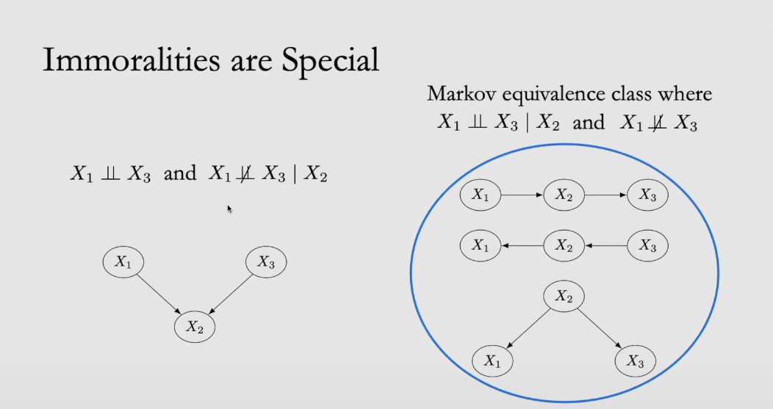
MOTIVATION
Causality instead of correlation
We can only differentiate cases from their respective Markov equivalence class:
Notes:
Immoralities is the attribute of this set of graphs which change independence if conditioned on X2 (of colliders)
Called immoralities because x2 have parents but their not married.
This separates them to two classes of graphs which are Markov equivalent

Slide 36
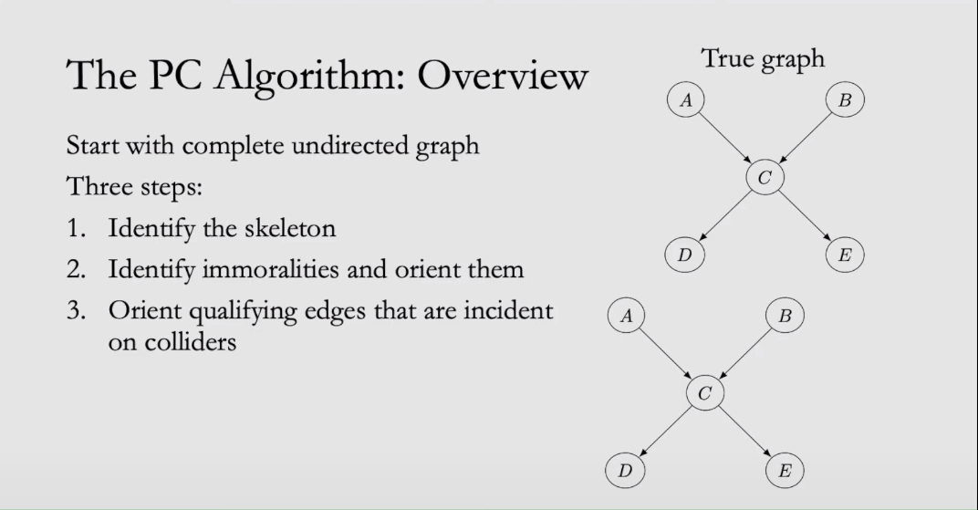
MOTIVATION
Causality instead of correlation
An example of an algorithm of Causal Discovery
Notes:
A skeleton is a directed graph turned un-directed.
PC is dependent on accurate dependency scores and returns candidates for the true graph based on immoralities.
That is the downside. We get several true graphs.

Slide 37
MOTIVATION
Causality instead of correlation
Counterfactual Analysis
Notes:
Under the assumption we have a SCM (parametric model of the variables)

Slide 38
MOTIVATION
Causality instead of correlation
Counterfactual Analysis
Counterfactual analysis required SCM (structural casual model)
At the unit level – Parametric model is needed (strong assumption)
At population level – Parametric model is not needed, we can estimate (like with ATE).

Slide 39
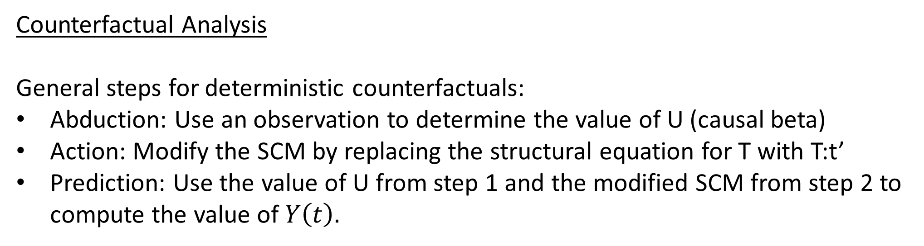
MOTIVATION
Causality instead of correlation
Counterfactual Analysis
General steps for deterministic counterfactuals:
Abduction: Use an observation to determine the value of U (causal beta)
Action: Modify the SCM by replacing the structural equation for T with T:t’
Prediction: Use the value of U from step 1 and the modified SCM from step 2 to compute the value of $Y\left(t\right).$

Slide 40
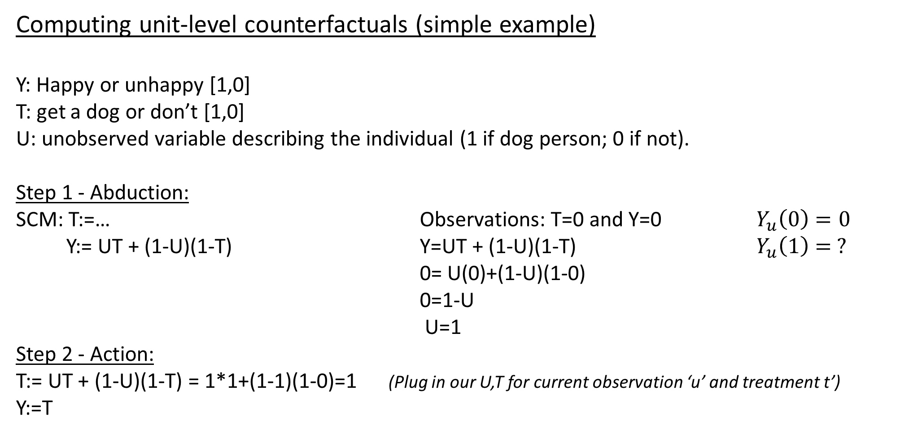
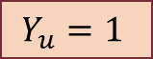
MOTIVATION
Computing unit-level counterfactuals (simple example)
Y: Happy or unhappy [1,0]
T: get a dog or don’t [1,0]
U: unobserved variable describing the individual (1 if dog person; 0 if not).
Step 1 - Abduction:
SCM: T:=… Observations: T=0 and Y=0 $Y_{u}\left(0\right)=0$
Y:= UT + (1-U)(1-T) Y=UT + (1-U)(1-T) $Y_{u}\left(1\right)= ?$
0= U(0)+(1-U)(1-0)
0=1-U
U=1
Step 2 - Action:
T:= UT + (1-U)(1-T) = 1*1+(1-1)(1-0)=1 (Plug in our U,T for current observation ‘u’ and treatment t’)
Y:=T
Causality instead of correlation
Step 3 - Prediction:
$$Y_{u}=1$$
ITE(individual treatment affect) = $Y_{u}\left(1\right)−Y_{u}\left(0\right)=1−0=1$

